Slide 1

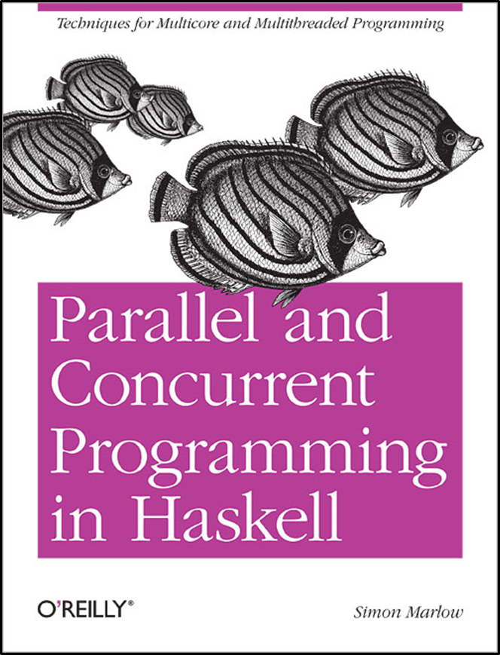

IMPLEMENTAREA CONCURENTEI IN LIMBAJE DE PROGRAMARE
Concurenta
Threaduri
Memorie Partajata
Ioana Leustean
takeMVar
Part II. Concurrent Haskell
Cap.7 & 8
https://hackage.haskell.org/package/base-4.20.0.1/docs/Control-Concurrent.html

Slide 2
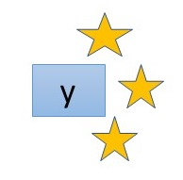
Monada este o clasa de tipuri
Intuitie:
functii care calculeaza o valoare si
produc un efect
class Applicative m => Monad m where
(>>=) :: m a -> (a -> m b) -> m b
(>>) :: m a - > m b -> m b
return :: a -> m a
ma >> mb = ma >>= \_ -> mb
x
m a este tipul computatiilor care produc rezultate de tip a si au efecte laterale
a −> m b este tipul continuarilor / al functiilor cu efecte laterale
>>= este operatia de „secventiere” a computatiilor
return este o functie care produce efectul nul

Slide 3
do notation
x <- e e >>= \x -> rest
rest
e e >>= \_ -> rest
rest
e e >> rest
rest
De exemplu
e1 >>= \x1 ->
e2 >> e3
devine
do
x1 <- e1
e2
e3

Slide 4
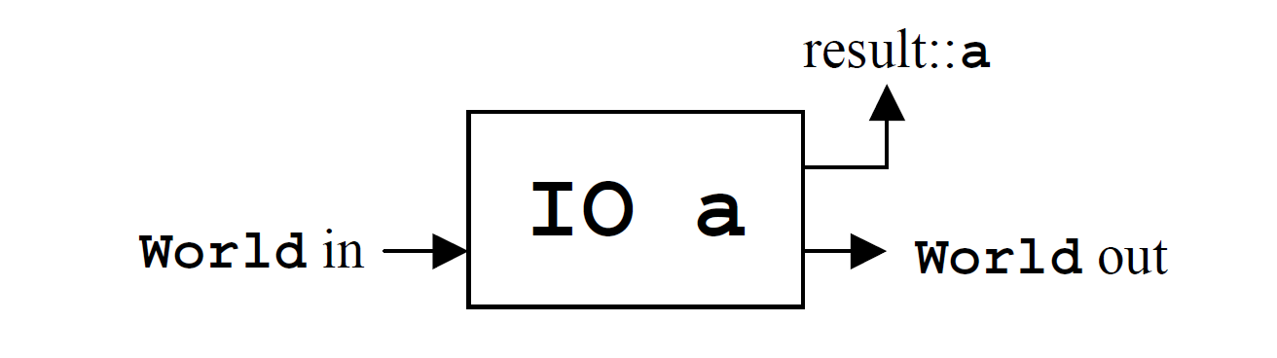
Monada IO
Intrarile si iesirile sunt valori de tipul IO a
() unit este singura valoare a tipului () (singleton)
IO () este folosit atunci cand actiunile
nu intorc valori semnificative
Valoarea de tip a dintr-o valoare
de tip IO a se obtine folosind <-
s <- getLine
c <- getChar

Slide 5
Actiuni IO
O valoare de tip (IO a) este o actiune care, daca este executata,
produce o data de tip a.
Actiunile se comporta asemenea instructiunilor.
Secventele de actiuni de obtin folosind notatia do.
pg = do putStrLn "Numele"
s <- getLine
putStrLn ("Hello " ++ s)

Slide 6
Blocul do
In general un bloc do poate fi descris ca o secventa de
Instructiuni, iar o instructiune poate fi:
actiune, adica o expresie de tipul IO (de ex: getLine)
o legatura <- ( de ex: s <- getLine)
o declaratie let (fara in)
un apel al functiei return
pg = do putStrLn "introdu sirul"
s <- getLine
let n = length s -- n este din clasa Num a
t=n*n
putStrLn (s ++ " are " ++ (show n) ++ " litere")

Slide 7
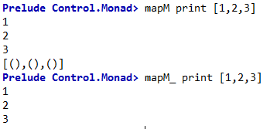
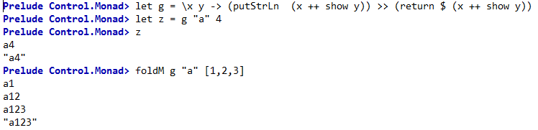
Functii monadice: sequence, sequence_, mapM, mapM_, foldM, foldM_

Slide 8
Variabile mutabile: IORef
add :: IORef Int -> Int -> IO()
add rref n = do
val <- readIORef rref
writeIORef rref
main = do
rref <- newIORef 0
add rref 10
val <- readIORef rref
print val
import Data.IORef
-- variabile mutabile in monada IO
newIORef :: a -> IO (IORef a)
readIORef :: IORef a -> IO a
writeIORef :: IORef a -> a -> IO ()

Slide 9
"Haskell does not take a stance on which
concurrent programming model is best:
actors, shared memory, and transactions are all supported, for example."
"Haskell provides all of these concurrent programming models and more - but this flexibility is a double-edged sword. The advantage is that you can choose from a wide range of tools and pick the one best suited to the task at hand, but the disadvantage is that it can be hard to decide which tool is best for the job."

Slide 10
Thread-urile in Haskell:
Thread-urile au efecte si interactioneaza cu lumea exterioara.
Programarea concurenta in Haskell are loc in monada IO.
La rulare, efectele thread-urilor sunt intercalate nedeterminist.
Thread-urile in Haskell sunt create si gestionate intern,
fara a folosi facilitati specifice sistemului de operare.
Implementarea threadurilor asigura verificarea anumitor conditii de corectitudine.

Slide 11
Crearea thread-urilor
forkIO :: IO () -> IO ThreadId
import Control.Concurrent
import Control.Monad
main = do
forkIO (replicateM_ 100 (putChar 'A')) -- child thread
replicateM_ 100 (putChar 'B') -- main thread
replicateM

Slide 12
forkIO :: IO () -> IO ThreadId
import Control.Concurrent
import Control.Monad
main = do
forkIO (replicateM_ 100 (putChar 'A')) -- child thread
replicateM_ 100 (putChar 'B') -- main thread
La rulari diferite se pot obtine rezultate diferite!

Slide 13
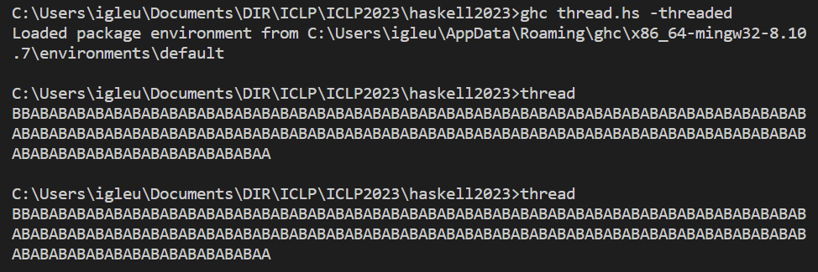
forkIO :: IO () -> IO ThreadId
import Control.Concurrent
import Control.Monad
main = do
forkIO (replicateM_ 100 (putChar 'A')) -- child thread
replicateM_ 100 (putChar 'B') -- main thread
Daca fisierul se numeste thread.hs
atunci el poate fi compilat si executat:
ghc thread.hs -threaded
thread
La rulari diferite se pot obtine rezultate diferite!

Slide 14
forkIO :: IO () -> IO ThreadId
myThreadId :: IO ThreadId
import Control.Concurrent
import Control.Monad
main = do
forkIO (replicateM_ 100 (myThreadID >>= print)) -- child thread
replicateM_ 100 (myThreadID >>= print) -- main thread

Slide 15
"The computation passed to forkIO is executed in a new thread that runs concurrently with the other threads in the system. If the thread has effects, those effects will be interleaved in an indeterminate fashion with the effects from other threads."
S. Marlow, PCPH
"forkIO is assymetrical: when a process executes a forkIO it spawns a child process that executes concurrently with the continued execution of the parent"
SL Peyton Jones, A Gordon, S Finne, Concurrent Haskell
"GHC's runtime system treats the program's original thread of control differently from other threads.
When this thread finishes executing, the runtime system considers the program as a whole to have completed.
If any other threads are executing at the time, they are terminated."
B. O'Sullivan, D. Stewart, J. Goerzen, Real World Haskell

Slide 16
Interleaving
import Control.Concurrent
import Control.Monad
myread1 = do
putStrLn "thread1"
s<- getLine
putStrLn $ "citit 1: " ++ s
myread2 = do
putStrLn "thread2"
s<- getLine
putStrLn $ "citit 2:" ++ s
main = do
forkIO (replicateM_ 10 myread1)
replicateM_ 10 myread2

Slide 17
Executie secventiala vs executie concurenta
fib 0 =1
fib 1 =2
fib n = fib (n-1) + fib (n-2)
act n = do
let x = (fib n)
putStrLn ("Fib " ++ (show n) ++ " is " ++ (show x))
act4 = do
act 10
act 20
act 30
act 35
getLine
main = do
forkIO $ act 10
forkIO $ act 20
forkIO $ act 30
forkIO $ act 35
getLine

Slide 18
Executie secventiala vs executie concurenta
Prelude> :set +s
Prelude> :l test.hs
[1 of 1] Compiling Main ( test.hs, interpreted )
Ok, one module loaded.
(0.09 secs,)
*Main> act4
Fib 10 is 144
Fib 20 is 17711
Fib 30 is 2178309
Fib 35 is 24157817
""
(115.38 secs, 11,248,521,824 bytes)
*Main> main
FiFFFbiii bbb1 0233 005i siii sss1 4147
711
2178309
24157817
""
(114.36 secs, 57,352 bytes)
act4 = do
act 10
act 20
act 30
act 35
getLine
main = do
forkIO $ act 10
forkIO $ act 20
forkIO $ act 30
forkIO $ act 35
getLine
Atentie!
Accesul la stdout nu este thread-safe,
deci trebuie sincronizat

Slide 19
Compilare cu -threaded
act4 = do
act 10
act 20
act 30
act 35
getLine
main = do
forkIO $ act 10
forkIO $ act 20
forkIO $ act 30
forkIO $ act 35
getLine
*Main> :! ghc --make -threaded test.hs
programul este compilat cu optiunea
-threaded
> .\test +RTS -N4 -s
Fib 10 is 144
Fib 20 is 17711
Fib 30 is 2178309
Fib 35 is 24157817
INIT time 0.000s ( 0.001s elapsed)
MUT time 4.672s ( 7.394s elapsed)
GC time 0.156s ( 0.120s elapsed)
EXIT time 0.000s ( 0.001s elapsed)
Total time 4.828s ( 7.515s elapsed)

Slide 20
-threaded
"Link the program with the “threaded” version of the runtime system.
The threaded runtime system […] enables the -N ⟨x⟩ RTS option to be used, which allows threads to run
in parallel on amultiprocessor or multicore machine.
Note that you do not need -threaded in order to use concurrency; the single-threaded runtime
supports concurrency between Haskell threads just fine."
https://downloads.haskell.org/~ghc/9.10.1/docs/users_guide/phases.html
"Concurrent Haskell is a collective name for the facilities that Haskell provides for programming with
multiple threads of control. Unlike parallel programming, where the goal is to make a program run
faster by using more CPUs, the goal in concurrent programming is usually to write a program with
multiple interactions."
S. Marlow, PCHP

Slide 21


Comunicarea thread-urilor
MVar
mutable variable

Slide 22

Comunicarea folosind MVar se face in monada IO
data MVar a
o data de tipul MVar a reprezinta o locatie mutabila care poate fi goala sau
poate contine o singura valoare de tip a
thread-urile pot comunica prin intermediul datelor de tip MVar
m :: MVar a
poate fi vazuta ca:
un semafor binar
un monitor cu o variabila
m

Slide 23
Comunicarea folosind MVar se face in monada IO
data MVar a
newEmptyMVar :: IO (MVar a) -- m <- newEmptyMVar
-- m este o locatie goala
newMVar :: a -> IO (MVar a) -- m <- newMVar v
-- m este o locatie care contine valoarea v
takeMVar :: MVar a -> IO a -- v <- takeMVar m
-- intoarce in v valoarea din m si goleste m
-- asteapta (blocheaza thread-ul) daca m este goala
putMVar :: Mvar a -> a -> IO() -- putMVar m v
-- pune in m valoarea v
-- asteapta (blocheaza thread-ul) daca m este plina
m

Slide 24
takeMVar
takeMVar este o operatie care blocheaza thread-urile
takeMVar este single-wakeup:
daca variabila MVar este.. goala, toa.te thread-urile care vor sa execute
takeMVar sunt blocate; cand variabila devine plina, un singur thread
este trezit si acesta va executa takeMVar
daca mai multe thread-uri sunt blocate pe acelasi MVar, ele vor fi trezite in ordinea FIFO
https://www.haskell.org/hoogle/?hoogle=MVar

Slide 25
takeMVar vs readMVar
readMVar
Citeste atomic continutul unui MVar.
Daca variabile MVar este goala, thread-ul care apeleaza readMVar va astepta pana cand MVar primeste o valoare si va citi valoarea pusa de urmatoarea operatie putMVar.
readMVar este multiple-wakeup, deci toate thread-urile care asteapta sa citeasca din MVar vor fi trezite in acelasi timp.
Implementarea veche
readMVar :: MVar a -> IO a
readMVar m = do
a <- takeMVar m
putMVar m a
return a
Implementarea actuala garanteaza ca readMVar este o
operatie atomica.
https://www.haskell.org/hoogle/?hoogle=MVar

Slide 26
Variabile mutabile: IORef, MVar
import Data.IORef
-- variabile mutabile in monada IO
newIORef :: a -> IO (IORef a)
readIORef :: IORef a -> IO a
writeIORef :: IORef a -> a -> IO ()
import Control.Concurrent.MVar
-- variabile de sincronizare
-- variabile mutabile in monada IO
newEmptyMVar :: IO (MVar a)
newMVar :: a -> IO (MVar a)
takeMVar :: MVar a -> IO a -- blocheaza thread-ul
putMVar :: MVar a -> a -> IO () -- blocheaza thread-ul
add :: IORef Int -> Int -> IO()
add rref n = do
val <- readIORef rref
writeIORef rref
main = do
rref <- newIORef 0
add rref 10
val <- readIORef rref
print val

Slide 27
import Control.Concurrent
main = do
m <- newEmptyMVar
forkIO $ do
putMVar m 'x'
putMVar m 'y'
x <- takeMVar m
print x
x <- takeMVar m
print x
newEmptyMVar :: IO (MVar a)
putMVar :: MVar a -> a -> IO()
takeMVar :: MVar a -> IO a

Slide 28
import Control.Concurrent
main = do
m <- newEmptyMVar
takeMVar m

Slide 29
Sincronizare : doua thread-uri incrementeaza acelasi contor
vrem sa citim valoarea contorului dupa ce ambele thread-uri au terminat
add m = replicateM_ 1000 $ do
x <- takeMVar m
putMVar m (x +1)
main = do
m <- newMVar 0
forkIO (add m )
forkIO (add m )
x <- takeMVar m
print x

Slide 30
Sincronizare : doua thread-uri incrementeaza acelasi contor
vrem sa citim valoarea contorului dupa ce ambele thread-uri au terminat
add m = replicateM_ 1000 $ do
x <- takeMVar m
putMVar m (x +1)
main = do
m <- newMVar 0
forkIO (add m )
forkIO (add m )
x <- takeMVar m
print x

Slide 31
Sincronizare : doua thread-uri incrementeaza acelasi contor
vrem sa citim valoarea contorului dupa ce ambele thread-uri au terminat
add m = replicateM_ 1000 $ do
x <- takeMVar m
putMVar m (x +1)
main = do
m <- newMVar 0
forkIO (add m )
forkIO (add m )
x <- takeMVar m
print x
trebuie sa ne asiguram
ca ambele thred-uri
au terminat

Slide 32
Sincronizare
add m ms1 = do
replicateM_ 1000 $ do
x <- takeMVar m
putMVar mv (x +1)
putMVar ms1 "ok"
main = do
m <- newMVar 0
ms1 <- newEmptyMVar
ms2 <- newEmptyMVar
forkIO (add m ms1)
forkIO (add m ms2)
takeMVar ms1
takeMVar ms2
x <- takeMVar m
print x
variabilele ms1 si ms2 actioneaza ca niste semafoare ;
astfel ne asiguram ca ambele thread-uri au terminat

Slide 33
Sincronizare
add m ms1 = do
replicateM_ 1000 $ do
x <- takeMVar m
putMVar mv (x +1)
putMVar ms1 "ok"
main = do
m <- newMVar 0
ms1 <- newEmptyMVar
ms2 <- newEmptyMVar
forkIO (add m ms1)
forkIO (add m ms2)
takeMVar ms1
takeMVar ms2
x <- takeMVar m
print x

Slide 34
Sincronizare: doua thread-uri incrementeaza acelasi contor
threadDelay nr
suspenda thread-ul pt.nr microsecunde
main = do
m <- newMVar 0
ms1 <- newEmptyMVar
ms2 <- newEmptyMVar
forkIO (add1 m ms1)
forkIO (add2 m ms2)
takeMVar ms1
takeMVar ms2
x <- takeMVar m
print x
add1 m ms1 = do
replicateM_ 1000 $ do
x <- takeMVar m
threadDelay 100 –nu afecteaza sincronizarea
putMVar mv (x +1)
putMVar ms1 "ok"
Sincronizarea este asigurata de faptul
ca ambele thread-uri apeleaza intai takeMVar
add2 m ms2 = do
replicateM_ 1000 $ do
s<- takeMVar m
putMVar mv (s + 1)
putMVar ms2 "ok"

Slide 35
MVar ca semafor binar
newLock = newMVar () -- MVar care contine ()
aquireLock m = takeMVar m
releaseLock m = putMVar m ()
main = do
m <- newLock
forkIO $ forever (act1 m)
forkIO $ forever (act2 m)
getLine
forever repeta o actiune monadica
de un numar infinit de ori

Slide 36
MVar ca semafor binar
newLock = newMVar () -- MVar care contine ()
aquireLock m = takeMVar m
releaseLock m = putMVar m ()
act1 m = do
aquireLock m
print "I have the lock"
releaseLock m
main = do
m <- newLock
forkIO $ act1 m
forkIO $ act2 m
getLine
act2 m = do
aquireLock m
print "Now I am have the lock"
releaseLock m

Slide 37
MVar ca semafor binar
newLock = newMVar () -- MVar care contine ()
aquireLock m = takeMVar m
releaseLock m = putMVar m ()
main = do
m <- newLock
forkIO $ forever (act1 m)
forkIO $ forever (act2 m)
getLine

Slide 38

Comunicarea thread-urilor
main = do
aMVar <- newEmptyMVar
forkIO (threadA aMVar )
forkIO (threadB aMVar )
putStrLn ("main thread ends")
getLine
primeste o valoare citita msg,
o pune in a
A
citeste valoarea din a
si o afiseaza
B
threadA a = do
putStrLn "mesaj: "
msg <- getLine
if (msg == "end")
then
putMVar a msg
else do
putMVar a msg
threadA a
threadB a = do
x <- takeMVar a
if x == "end"
then putStrLn "I will stop now"
else do
putStrLn ("primit: " ++ x)
threadB a

Slide 39
Comunicarea thread-urilor
main = do
aMVar <- newEmptyMVar
forkIO (threadA aMVar )
forkIO (threadB aMVar )
putStrLn ("main thread ends")
getLine
primeste o valoare citita msg,
o pune in a
A
citeste valoarea din a
si o afiseaza
B
threadA a = do
putStrLn "mesaj: "
msg <- getLine
if (msg == "end")
then
putMVar a msg
else do
putMVar a msg
threadA a
threadB a = do
x <- takeMVar a
if x == "end"
then putStrLn "I will stop now"
else do
putStrLn ("primit: " ++ x)
threadB a
*Main> main
mmaeisna jt:h r
ead ends
Accesul la stdout nu este thread-safe,
deci trebuie sincronizat

Slide 40
Comunicarea thread-urilor
Accesul la stdout nu este thread-safe,
deci trebuie sincronizat
tswrite stdo msg = do
aquireLock stdo
putStrLn msg
releaseLock stdo
tsread stdo = do
aquireLock stdo
putStrLn "mesaj: "
msg <- getLine
releaseLock stdo
return msg
main = do
aMVar <- newEmptyMVar
stdo <- newLock
forkIO (threadA aMVar stdo)
forkIO (threadB aMVar stdo)
putStrLn ("main thread ends")
getLine

Slide 41
Comunicarea thread-urilor
threadA a s = do
msg <- tsread s
if (msg == "end")
then
putMVar a msg
else do
putMVar a msg
threadA a
main = do
aMVar <- newEmptyMVar
stdo <- newLock
forkIO (threadA aMVar stdo )
forkIO (threadB aMVar stdo)
putStrLn ("main thread ends")
getLine
threadB a s = do
x <- takeMVar a
if x == "end"
then tswrite s "I will stop now"
else do
tswrite s ("primit: " ++ x)
threadB a
*Main> main
main thread ends
mesaj:
m1
"m1"
Ce problema de sincronizare poate sa apara?
Thread-ul principal nu asteapta finalizarea activitatii thread-urilor.

Slide 42
Comunicarea thread-urilor
main = do
aMVar <- newEmptyMVar
stdo <- newLock
sem <- newLock
forkIO (threadA aMVar stdo )
forkIO (threadB aMVar stdo sem)
releaseLock sem
putStrLn ("main thread ends")
getLine
threadA a s = do
msg <- tsread s
if (msg == "end")
then
putMVar a msg
else do
putMVar a msg
threadA a
*Main> main
mesaj:
m1
mesaj:
m2
primit: m1
mesaj:
end
primit: m2
i will stop now
main thread ends
threadB a s = do
x <- takeMVar a
if x == "end"
then do
tswrite s "I will stop now"
aquireLock sem
else do
tswrite s ("primit: " ++ x)
threadB a

Slide 43
Producer-Consumer problem
MVar ca monitor
buffer
producator
consumator
import Control.Concurrent
import Control.Monad
main = do
m <- newEmptyMVar --buffer
forkIO (producer m )
consumer m 10 -- consuma 10 produse

Slide 44
Producer-Consumer problem
MVar ca monitor
producer :: MVar String-> IO ()
producer m = forever $ do
mes <- getLine
putMVar m mes
buffer
producator
consumator
import Control.Concurrent
import Control.Monad
main = do
m <- newEmptyMVar --buffer
l <- newLock
forkIO (producer m )
consumer m 10 -- consuma 10 produse
releaseLock l
putStrLn "main thread ends"
consumer :: MVar String -> Int -> MVar () ->IO()
consumer m n l = if (n == 0)
then aquireLock l
else
do
mes <- takeMVar m
putStrLn (">"++ mes)
consumer m (n-1)

Slide 45
Producer-Consumer problem
MVar ca monitor
buffer
producator
consumator
import Control.Concurrent
import Control.Monad
main = do
m <- newEmptyMVar --buffer
l <- newLock
forkIO (producer m )
consumer m 5 -- consuma 5 produse
releaseLock l
putStrLn "main thread ends"
*Main> main
m1
>m1
m2
>m2
m3
>m3
m4
>m4
m5
>m5
main thread ends

Slide 46

Sincronizare: serviciu de logare
modelarea unui canal de comunicare simplu folosind MVar
http://chimera.labs.oreilly.com/books/1230000000929/ch07.html#sec_conc-logger
msg
Mesaj 2
Mesaj 1
printStrLn msg
Cerinte:
serviciul de logare prelucreaza mesajele intr-un thread separat
mesajele trebuie prelucrate in ordinea in care sunt logate
cand programul se termina toate mesajele logate trebuie sa fie prelucrate

Slide 47

Exemplu: serviciu de logare – varianta1
msg
Mesaj 2
Mesaj 1
printStrLn msg
Logger
data Logger = Logger MVar String
initLogger :: IO Logger
initLogger = do
m <- newEmptyMVar
let log = Logger m -- log =
forkIO (logger log) -- creeaza
return log
logger :: Logger -> IO() -- prelucreaza mesajele din Logger
logger :: Logger -> IO ()
logger (Logger m) = loop
where
loop = do
msg<- takeMVar m
putStrLn msg
loop

Slide 48
Exemplu: serviciu de logare- varianta1
Mesaj 2
Mesaj 1
logMessage :: Logger -> String -> IO ()
logMessage (Logger m) s = putMVar m s
logMessThread:: Logger -> IO()
logMessThread l = do
msg <- getLine
if (msg == "bye")
then return()
else do
logMessage log msg
logMessTh log
main = do
log <- initLogger
logMessThread log
data Logger = Logger MVar String
initLogger :: IO Logger
initLogger = do
m <- newEmptyMVar
let log = Logger m
forkIO (logger log)
return log
logger :: Logger -> IO ()
logger (Logger m) = loop
where
loop = do
msg<- takeMVar m
putStrLn msg
loop
Creaza thread-ul logger
Thread-ul logger le citeste si le scrie
Thread-ul principal trimite messajele

Slide 49
Exemplu: serviciu de logare- varianta1
Mesaj 2
Mesaj 1
logMessage :: Logger -> String -> IO ()
logMessage (Logger m) s = putMVar m s
logMessThread:: Logger -> IO()
logMessThread log = do
msg <- getLine
if (msg == "bye")
then return()
else do
logMessage log msg
logMessTh log
main = do
log <- initLogger
logMessThread log
data Logger = Logger MVar String
initLogger :: IO Logger
initLogger = do
m <- newEmptyMVar
let log = Logger m
forkIO (logger log)
return log
logger :: Logger -> IO ()
logger (Logger m) = loop
where
loop = do
msg<- takeMVar m
putStrLn msg
loop
Ce problema de sincronizare poate sa apara?

Slide 50
Exemplu: serviciu de logare- varianta1
Mesaj 2
Mesaj 1
logMessage :: Logger -> String -> IO ()
logMessage (Logger m) s = putMVar m s
logMessThread:: Logger -> IO()
logMessThread log = do
msg <- getLine
if (msg == "bye")
then return()
else do
logMessage log msg
logMessTh log
main = do
log <- initLogger
logMessThread log
data Logger = Logger MVar String
initLogger :: IO Logger
initLogger = do
m <- newEmptyMVar
let log = Logger m
forkIO (logger log)
return log
logger :: Logger -> IO ()
logger (Logger m) = loop
where
loop = do
msg<- takeMVar m
putStrLn msg
loop
programul nu se asigura ca toate mesajele logate sunt prelucrate

Slide 51
Exemplu: serviciu de logare
-- la fel
initLogger :: IO Logger
initLogger = do
m <- newEmptyMVar
let log= Logger m
forkIO (logger log)
return log
main = do
log <- initLogger
logMessTh log
logMessage :: Logger -> String -> IO ()
logMessage (Logger m) s = putMVar m s
logMessThread:: Logger -> IO()
logMessThread log = do
msg <- getLine
if (msg == "bye")
then logStop log
else do
logMessage log msg
logMessTh log

Slide 52



Exemplu: serviciu de logare
data Logger = Logger (MVar LogCommand)
data LogCommand = Message String | Stop (MVar ())
msg
s
Stop s
Message msg
printStrLn msg
Stop s
putMVar s ()
s
()
takeMVar s
putMVar s ()

Slide 53
Exemplu: serviciu de logare
data Logger = Logger (MVar LogCommand)
data LogCommand = Message String | Stop (MVar ())
logMessage :: Logger -> String -> IO ()
logMessage (Logger m) s = putMVar m s
logMessThread:: Logger -> IO()
logMessThread log = do
msg <- getLine
if (msg == "bye")
then logStop log
else do
logMessage log msg
logMessTh log
logStop :: Logger -> IO ()
logStop (Logger m) = do
s <- newEmptyMVar
putMVar m (Stop s)
takeMVar s
logMessage :: Logger -> String -> IO ()
logMessage (Logger m) s = putMVar m (Message s)

Slide 54
Exemplu: serviciu de logare
data Logger = Logger (MVar LogCommand)
data LogCommand = Message String | Stop (MVar ())
logger :: Logger -> IO ()
logger (Logger m) = loop
where loop = do
cmd <- takeMVar m
case cmd of
Message msg -> do
putStrLn ("mesaj: " ++ msg)
loop
Stop s -> do
putStrLn "logger: stop"
putMVar s ()
Thread-ul logger va
debloca s cand cand
ajunge la Stop s
logStop :: Logger -> IO ()
logStop (Logger m) = do
s <- newEmptyMVar
putMVar m (Stop s)
takeMVar s
logger.hs ©2012, Simon Marlow

Slide 55
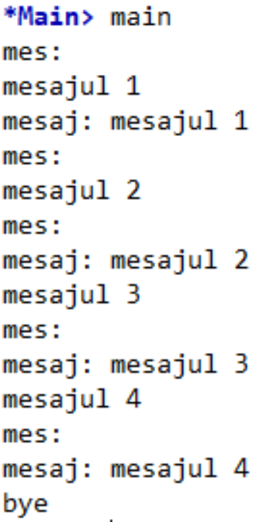
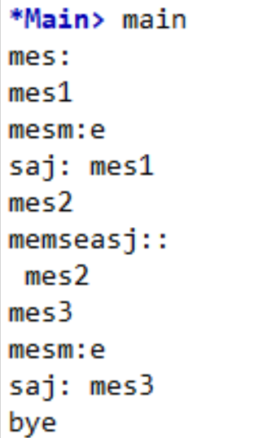
stdo <- newMVar ()
tswrite stdo s = do
takeMVar stdo
putStrLn s
putMVar stdo ()

Slide 56
Semafor cu cantitate (quantity semaphore)
import Control.Concurrent.QSem
data QSem
newQSem :: Int -> IO Qsem
waitQSem :: QSem -> IO() -- aquire, il ocupa
signalQSem :: QSem -> IO() -- release, il elibereaza
un semafor care sincronizeaza accesul la n resurse se defineste astfel:
qs <- newQsem n

Slide 57
Exemplu: QSem
O multime de taskuri acceseaza simultan o resursa reprezentata printr-un QSem;
pentru a se executa, fiecare task trebuie sa acceseaze resursa, pe care o elibereaza la sfarsitul executiei.
import Control.Concurrent
import Control.Monad
main :: IO ()
main = do
q <- newQSem 3
let workers = 5
mapM_ (forkIO . worker q m) [1..workers]
mapM_ :: (Foldable t, Monad m) => (a -> m b) -> t a -> m ()

Slide 58
Exemplu: QSem
O multime de taskuri acceseaza simultan o resursa reprezentata printr-un QSem;
pentru a se executa, fiecare task trebuie sa acceseaze resursa, pe care o elibereaza la sfarsitul executiei.
import Control.Concurrent
import Control.Monad
main :: IO ()
main = do
q <- newQSem 3
let workers = 5
mapM_ (forkIO . worker q m) [1..workers]
q este semaforul care controleaza resursele
worker :: QSem -> MVar String -> Int -> IO ()
worker q m w= do
waitQSem q
putStrLn$ "Worker " ++ show w ++ " acquired the lock."
threadDelay 2000000 -- microseconds
signalQSem q
putStrLn $ "Worker " ++ show w ++ "released the lock."
http://rosettacode.org/wiki/Metered_concurrency

Slide 59
Exemplu: QSem
O multime de taskuri acceseaza simultan o resursa reprezentata printr-un QSem;
pentru a se executa, fiecare task trebuie sa acceseaze resursa, pe care o elibereaza la sfarsitul executiei.
worker :: QSem -> MVar String -> Int -> IO ()
worker q m w= do
waitQSem q
putStrLn$ "Worker " ++ show w ++ " acquired the lock."
threadDelay 2000000 -- microseconds
signalQSem q
putStrLn $ "Worker " ++ show w ++ "released the lock."
import Control.Concurrent
import Control.Monad
main :: IO ()
main = do
q <- newQSem 3
let workers = 5
mapM_ (forkIO . worker q m) [1..workers]
q este semaforul care controleaza resursele
http://rosettacode.org/wiki/Metered_concurrency

Slide 60
Exemplu: QSem
O multime de taskuri acceseaza simultan o resursa reprezentata printr-un QSem;
pentru a se executa, fiecare task trebuie sa acceseaze resursa, pe care o elibereaza la sfarsitul executiei.
worker :: QSem -> Int -> IO ()
worker q m w= do
waitQSem q
putStrLn$ "Worker " ++ show w ++ " acquired the lock."
threadDelay 2000000 -- microseconds
signalQSem q
putStrLn $ "Worker " ++ show w ++ "released the lock."
import Control.Concurrent
import Control.Monad
main :: IO ()
main = do
q <- newQSem 3
let workers = 5
mapM_ (forkIO . worker q ) [1..workers]
q este semaforul care controleaza resursele
http://rosettacode.org/wiki/Metered_concurrency

Slide 61
Exemplu: QSem
O multime de taskuri acceseaza simultan o resursa reprezentata printr-un QSem;
pentru a se executa, fiecare task trebuie sa acceseaze resursa, pe care o elibereaza la sfarsitul executiei.
import Control.Concurrent
import Control.Monad
main :: IO ()
main = do
q <- newQSem 3
stdo <- newEmptyMVar
let workers = 5
prints = 2 * workers
mapM_ (forkIO . worker q m) [1..workers]
replicateM_ prints $ takeprint stdo
takeprint :: MVar String -> IO()
takeprint stdo = do
s <- takeMVar stdo
print s
worker :: QSem -> MVar String -> Int -> IO ()
worker q m w= do
waitQSem q
putMVar stdo $ "Worker " ++ show w ++ " acquired the lock."
threadDelay 2000000 -- microseconds
signalQSem q
putMVar stdo $ "Worker " ++ show w ++ "released the lock."
q este semaforul care controleaza resursele
stdo coordoneaza accesul la stdout
http://rosettacode.org/wiki/Metered_concurrency

Slide 62
in Concurrent Haskell
concurenta este nedeterminista

Slide 63

Implementarea QSem
type QSem = MVar (Int, [MVar ()])
newQSem :: Int -> IO QSem
newQSem n = newMVar (n,[])
-- qsem <- newQSem 3
waitQSem :: QSem -> IO() -- ocupa
signalQSem :: QSem -> IO() -- elibereaza
n = nr. de resurse
blki = un thread care cere acces la resursa
este blocat pe variabila blki
daca n > 0 atunci qsem = (n, [])
altfel qsem = ( 0, [blk1, blk2, …])
Implementarea din:
Concurrent Haskell
SL Peyton Jones, A Gordon, S Finne, 1996

Slide 64
Implementarea QSem - Concurrent Haskell SL Peyton Jones, A Gordon, S Finne, 1996
type QSem = MVar (Int, [MVar ()])
newQSem :: Int -> IO QSem
newQSem n = newMVar (n,[])
daca n > 0 atunci qsem = (n, [])
altfel qsem = ( 0, [blk1, blk2, …])
Ocuparea resursei
waitQSem :: QSem -> IO()
waitQSem qsem = do
(avail,blks) <- takeMVar qsem
if avail > 0
then putMVar qsem (avail-1, [])
else
do
blk <- newEmptyMVar
putMVar qsem (0, blk:blks)
takeMVar blk -- threadul e blocat pe variabila proprie

Slide 65
Implementarea QSem - Concurrent Haskell SL Peyton Jones, A Gordon, S Finne, 1996
type QSem = MVar (Int, [MVar ()])
newQSem :: Int -> IO QSem
newQSem n = newMVar (n,[])
daca n > 0 atunci qsem = (n, [])
altfel qsem = ( 0, [blk1, blk2, …])
Eliberarea resursei
signalQSem :: QSem -> IO()
signalQSem qsem = do
(avail,blks) <- takeMVar qsem
case blks of
[] -> putMVar qsem (avail+1,[])
(blk:blks') -> do
putMVar qsem (0,blks')
putMVar blk ()
fiecare thread elibereaza variabila proprie a unui thread in asteptare

Slide 66
Implementarea QSem - Concurrent Haskell SL Peyton Jones, A Gordon, S Finne, 1996
type QSem = MVar (Int, [MVar ()])
newQSem :: Int -> IO QSem
newQSem n = newMVar (n,[])
daca n > 0 atunci qsem = (n, [])
altfel qsem = ( 0, [blk1, blk2, …])
Ocuparea resursei
waitQSem :: QSem -> IO()
waitQSem qsem = do
(avail,blks) <- takeMVar qsem
if avail > 0
then putMVar qsem (avail-1, [])
else
do
blk <- newEmptyMVar
putMVar qsem (0, blk:blks)
takeMVar blk – threadul e blocat pe variabila proprie
Eliberarea resursei
signalQSem :: QSem -> IO()
signalQSem qsem = do
(avail,blks) <- takeMVar qsem
case blks of
[] -> putMVar qsem (avail+1,[])
(blk:blks') -> do
putMVar qsem (0,blks')
putMVar blk ()
atentie la ordinea de asteptare!
atentie la ordinea de asteptare!
fiecare thread elibereaza variabila proprie a unui thread in asteptare

